Slide 1
Datacenter Cloud Assessment
Migrating Apps, Workloads, and Data to Azure

Slide 2
Executive Summary What: This is a free assessment to assess your I.T environment cloud readiness for migration to Azure. How: Utilizing Microsoft’s partnersto assess your virtual and physical server environments. Why: To assist you in taking your first steps on your cloud journey.
Agenda
Your datacenter cloud readiness assessment
Why Microsoft Azure
The assessment process
Sample Report Output
Microsoft Partner Network
Notes:
There are many scenarios under which Lift and Shift is the best approach:
Want to move to Cloud as-is to lower your maintenance costs taking advantage of cloud infrastructure
Want to avoid the burden of owning on-premises servers and data centers.
Need a scale-on-demand capacity with no change in application environment needed.
Need disaster recovery

Slide 3
Your datacenter cloud readiness assessment
Following on from the assessment we will arrange a meeting to discuss your assessment with you
Should you wish to proceed with your migration to Azure we will arrange a meeting to schedule the next actions
Free assessment of your physical and virtual environments with dependency discovery
Azure readiness report would be generated
Indicative cost of Azure server, network, and storage infrastructure based on current utilization
1: What
4: Next Steps
Cost model transformation CapEx to OpEx
Datacenter modernization insight
Modern security and new capabilities such as advanced analytics & AI
Cloud scale and elasticity
Pay for what you use – consumption
2: How
Agent-based and agent-less options
Assessment will take place over 2-4 weeks depending on your environment
Only metadata is collected – no customer data
3: Why

Slide 4
Why Microsoft Azure?
Azure. Cloud for all.
Productive
Hybrid
Intelligent
Trusted
Notes:
These 4 pillars represent the main value proposition for what differentiates Azure from the competition. As you can see in the proof points, these are the reason why customers choose Microsoft, because of the unique value that we provide in a productive, hybrid, intelligent, and trusted cloud.
Productive
Get unparalleled developer productivity with integrated tools from mobile DevOps to serverless computing.
Learn about accelerating innovation
Hybrid
Develop and deploy where you want, with the only consistent hybrid cloud on the market. Extend Azure on-premises with Azure Stack.
Learn about our consistent hybrid cloud
Intelligent
Create intelligent apps that delight with data-driven experiences. Go quickly from concept to release with Azure data services and artificial intelligence, from image recognition to bot services.
Learn about intelligent apps
Trusted
Join startups, governments, and 90 percent of Fortune 500s that trust the Microsoft Cloud for security, privacy, transparency, and the most compliance coverage of any cloud provider.

Slide 5
Productive
Hybrid
Intelligent
Trusted
Notes:
Productive, hybrid, intelligent, trusted
In order to satisfy the demands of keeping up in the modern world, you need a platform that has these four qualities.
This is the unique value proposition that Microsoft offers.
[this is a good place to give a personal story of how your customers are making their journey to the cloud]

Slide 6
Azure. Cloud for all.
Productive
Hybrid
Intelligent
Trusted
Notes:
Azure. Cloud for all.
These 4 pillars represent the main value proposition for what differentiates Azure from the competition.
As you can see in the proof points, these are the reason why customers choose Microsoft, because of the unique value that we provide in a productive, hybrid, intelligent, and trusted cloud.
With Azure, you can do—or be—all of these things.
Productive
Get unparalleled developer productivity with integrated tools from mobile DevOps to serverless computing.
Learn about accelerating innovation
Hybrid
Develop and deploy where you want, with the only consistent hybrid cloud on the market. Extend Azure on-premises with Azure Stack.
Learn about our consistent hybrid cloud
Intelligent
Create intelligent apps that delight with data-driven experiences. Go quickly from concept to release with Azure data services and artificial intelligence, from image recognition to bot services.
Learn about intelligent apps
Trusted
Join startups, governments, and 90 percent of Fortune 500s that trust the Microsoft Cloud for security, privacy, transparency, and the most compliance coverage of any cloud provider.

Slide 7
Unparalleled developer productivity
Productive
Integrated tooling
Visual Studios Third parties | DevOps
100+ services
Azure Functions Kubernetes | Logic Apps
Unified management
Single cloud | Policy
Hybrid
Intelligent
PLAN
DEPLOY
INTEGRATION
CONTINUOUS DEVELOPMENT
Trusted
CONTINUOUS
BUILD
OPERATE
Notes:
Use any dev tool or language
Build applications using the language of your choice including Node.js, Java, .NET.
Leverage best in class development tools, Visual Studio or Visual Studio Code, either on your PC or Mac.
Get apps to users faster by streamlining the mobile development lifecycle with Visual Studio Mobile Center, including automated builds and testing.
Choice of more than 100 services
Engage with users in richer ways whether in native mobile apps, responsive web apps, or through new experiences like bots and mixed reality. Use the best in class support by Visual Studio family of tools and 100+ of Azure Cloud Services.
Develop with open source technologies like Kubernetes, modernize applications using serverless computing with Azure Functions, and use AI and data to infuse intelligence into your solutions.
Easily connect applications, data, and devices taking advantage of 150+ out-of-the-box Azure Logic Apps connectors for Salesforce, Office 365, Twitter, Dropbox, Google services, and more.
Explore Azure products and services
End-to-end management experience
Manage applications no matter how large or complex. Use your choice of management tools including the Azure portal, Power Shell, BASH, or REST APIs.
Azure provides built-in support for things like monitoring, log analytics, patching, backup and site recovery.
Azure portal Azure Cloud Shell
Accelerate application delivery with agile development practices
Encourage devops practices and cross-team collaboration using Visual Studio Team Services. Enable continuous integration and delivery (CI/CD) for any app written in any language.
Quickly find production issues with Azure Application Insights, while saving time and money spinning up and maintaining cloud dev-test environments.
Build software your way with integration to popular open-source software and tools such as Jenkins and Chef.
Learn more about Visual Studio Team Services

Slide 8
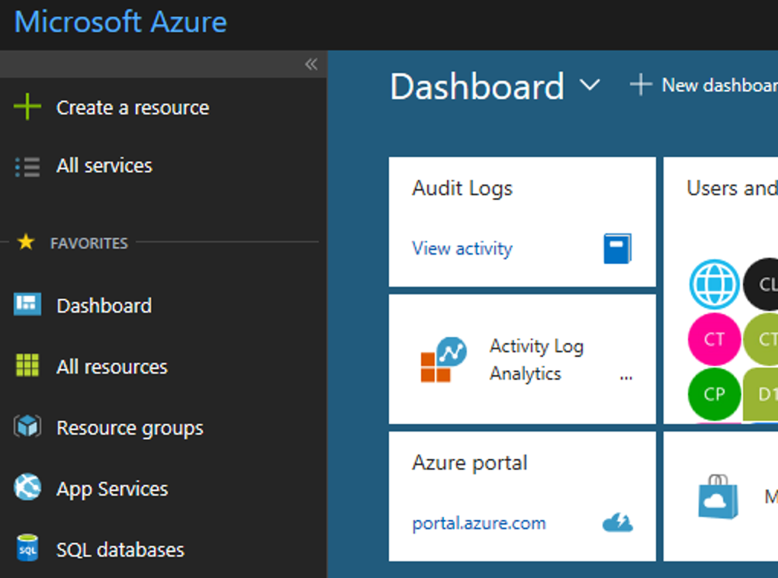
Secure and well-managed for IT
Productive
Govern
Secure
Policy management
Cost management
Security management
Threat protection
Hybrid
Azure portal
Configure
Protect
Intelligent
Update management, scripting
Automation, configuration
Backup and disaster recovery
Trusted
Monitor
App, infrastructure, and network monitoring
Log analytics and diagnostics
Notes:
Built-in Security and Management in Azure
To be successful in the Cloud era, enterprises must have visibility/metrics and controls on every component to pinpoint issues efficiently, optimize and scale effectively, while having the assurance the security, compliance and polices are in place to ensure the velocity.
Start in the middle with the Azure portal
- With Azure you get enterprise grade management capabilities built-in to the platform – all services and resources together in a single, easy-to-use portal. You can create dashboards, use the friendly search and intuitive menus, quick start resource templates, and more.
- With a single platform, you get integrated and interconnected tools and data, with unified metrics and alerts across your services. So you don’t have to go to different portals with different datasets.
- Using out-of-the-box tools (like Azure Advisor, Azure Service Health, and Cost Management + Billing), you can optimize and right-size your investment and get personalized recommendations to enhance your experience.
Expand to the 5 areas of security and management
5 main areas:
Secure: While Azure is trusted and secure platform, you as a customer have your own security settings you need to manage. You also need to be able to protect your individual machines against threats and monitor the security posture of your system.
Protect: Your VMs and applications in the cloud need to be backed up and protected in the event of data loss. With disaster recovery from on-prem to the cloud, or from one cloud to another, you can avoid downtime and keep your applications up and running.
Monitor: Every operations manager and every developer needs to be able to see the health and performance of their applications, infrastructure, and network. And seeing insights across all three together in a single dashboard can save time and resources in troubleshooting and preventing issues in the future.
Configure: For managing Azure and hybrid workloads at scale, automation and configuration capabilities help you create runbooks to automate tasks, manage the configuration settings and track changes, and monitor and deploy missing updates. Additionally in Azure you can use PowerShell and Cloud Shell for command line scripting.
Govern: Many customers need a way to look across cloud resources to assess and enforce enterprise-wide standards and policy compliance for security and management. In addition, they need to manage and monitor costs for the cloud, not just in Azure but in other clouds too.
Lastly, Azure gives you the flexibility to manage your hybrid environments with most of these services. And you can choose which areas to invest more in, and how much to consume.
With Azure you have the flexibility to choose what and how to manage your IT.

Slide 9
The only consistent, hybrid cloud
Azure Active Directory
Azure services
Azure data services
Azure Security and Management
Productive
Hybrid
Common identity
Unified cloud platform
Data
platform
Security and management
Intelligent
Trusted
Active Directory
Azure
Stack
SQL
Server
On-premises infrastructure
Notes:
Hybrid
The strength of the hybrid strategy is about the continuum of capabilities across the offerings, it’s not just about the platform.
Hybrid is more than just being able to move an application into the cloud.
There are critical elements from identity, data, and security and management that have to be addressed.
You don’t have to be stuck in an all-or nothing choice – hybrid gives you the flexibility to move to the cloud when and how you want to.

Slide 10
Azure Stack: an extension of Azure
Productive
Hybrid
Intelligent
At the edge and disconnected
Meet every regulatory requirement
Cloud application model on-premises
Trusted
Notes:
Azure Stack: an extension of Azure
One important aspect of the hybrid approach is Azure Stack.
What is Azure Stack?
It’s the code of Azure that is instantiated on a small footprint, a on-premises server stack.
You can build applications using the same APIs, same capabilities, and the same management portal.
There are three reasons you may want to do that:
First, the disconnected and edge scenarios.
For example, cruise ships roaming the oceans that are not always connected, oil rigs in a remote situation that might not have high bandwidth.
Your application can run in Azure for connected environments and locally on Azure Stack for the disconnected environments.
The second scenario is regulatory.
Where there are specific regulatory requirements about data leaving the country, but there is no Azure data center, you can have Azure Stack to meet local regulatory requirements.
The last one is where you may want to move to cloud-first model but are limited due to restrictions such as having a mainframe application that cannot be moved to the cloud and you need to have it close to the cloud components.
Azure Stack is delivered as an integrated systems. It is delivered through hardware partners such as Dell and HP.

Slide 11





Machine Learning Workbench
Productive
Language APIs
Azure SQL DB
Hybrid
Azure
AI for every developer and every scenario
Intelligent
Azure Machine Learning
Vison API
Trusted
Azure Bot Service
Notes:
Microsoft Azure: the cloud for intelligent solutions
In addition to having the traditional on-premises enterprise data tools—such as SQL Server—Azure provides SQL services that connects data to AI services.
This enables quick adoption of technologies, such as deploying a global mobile application that integrates with facial recognition services.
The ease of integration enables anyone to build solutions like that.
From bot frameworks to cognitive services, you can fundamentally change the way your business goes to market with Microsoft’s power AI platform

Slide 12
Comprehensive deep learning,
machine learning as a service
Productive
Hybrid
Customizable services
VS, ML STUB, Tensor, Caffe
Tools
Bots, Cognitive, ML
Infrastructure and compute
CPU, GPU, FPGA
Intelligent
Azure
Trusted
Notes:
Develop breakthrough apps with built-in intelligence
Take advantage of a comprehensive set of services, infrastructure, and tools to build AI-powered experiences including bots that naturally interact with users and built-in advanced analytics tools, such as R, to make faster predictions.
Elastically scale storage and performance with Azure Cosmos DB, the first globally distributed database service that delivers horizontal scale-out with guaranteed single digit millisecond latency.
Rest assured with managed service capabilities such as built-in monitoring, threat detection, automatic patching, and backups.
Expand your possibilities with an open platform
Build apps for any scenario with familiar technologies of your choice and a comprehensive set of data engines such as PostgreSQL, MySQL, MongoDB and Hadoop.
Leverage advanced analytics and AI services and tools such as Spark, and Jupyter Notebooks.
Build and deploy custom AI models at scale
Work across teams to build, test and manage different versions of your models in production with Azure Machine Learning Studio, Workbench, Experimentation, and Model management. Build rich AI applications with a family of GPUs `optimized for deep learning AI scenarios and run large-scale, massively parallel development with Azure Batch. Debug, test and deploy across platforms with Visual Studio Code.

Slide 13




































More certifications than any cloud provider
GLOBAL
ISO 27001
ISO 27018
ISO 27017
ISO 22301
SOC 1 Type 2
Productive
SOC 2 Type 2
SOC 3
CSA STAR
Self-Assessment
CSA STAR
Certification
CSA STAR
Attestation
Hybrid
INDUSTRY
PCI DSS
Level 1
CDSA
MPAA
FACT UK
Shared
Assessments
FISC Japan
HIPAA / HITECH Act
Intelligent
HITRUST
GxP
21 CFR Part 11
MARS-E
IG Toolkit UK
FERPA
GLBA
FFIEC
REGIONAL
Argentina PDPA
EU
Model Clauses
UK
G-Cloud
China
DJCP
China
GB 18030
China
TRUCS
Singapore
MTCS
Australia
IRAP/CCSL
New Zealand
GCIO
Trusted
Japan My
Number Act
ENISA
IAF
Japan CS Mark Gold
Spain
ENS
Spain
DPA
India
MeitY
Canada
Privacy Laws
Privacy
Shield
Germany IT
Grundschutz
workbook
Notes:
Trusted
Compliance and trust is not an afterthought at Microsoft.
We are leaders in this space, and help set standards for global and federal organizations around the world.
Microsoft has been talking about trust in the cloud for a while and will continue to do so.
This is only a sampling of our compliance certifications, but we run the gamut.
Azure’s strengths are around security, privacy, and transparency around how we run the cloud.

Slide 14
Productive
Hybrid
Intelligent
54
Azure regions
Trusted
Learn more: Microsoft.com/datacenter
Notes:
Trusted
Azure is continuing expand its infrastructure footprint around the globe.
In fact, Microsoft is the first cloud provider to put data centers in South Africa.
Right now, we’re at 42 Azure regions—which is more than AWS and Google combined.
The approach Azure takes is different as it is important for enterprise customers to have data in region, close to employees, close to customers as well as have unique data handling capabilities.
Learn more:
For more information on how we run and secure the datacenters, there are more resources online.
Tours are available for our datacenters if you wish to see the capabilities and technologies that are in use in Azure.

Slide 15
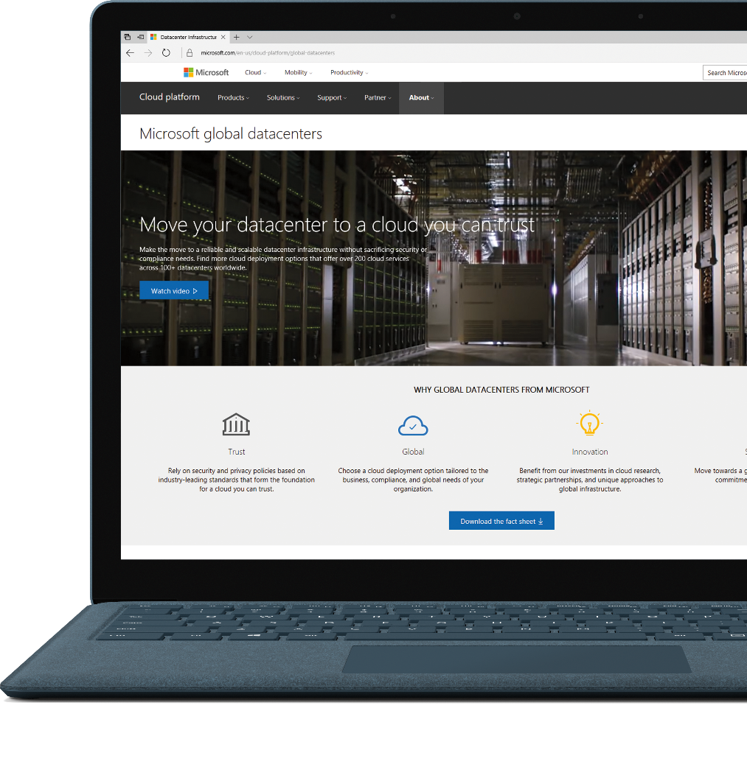
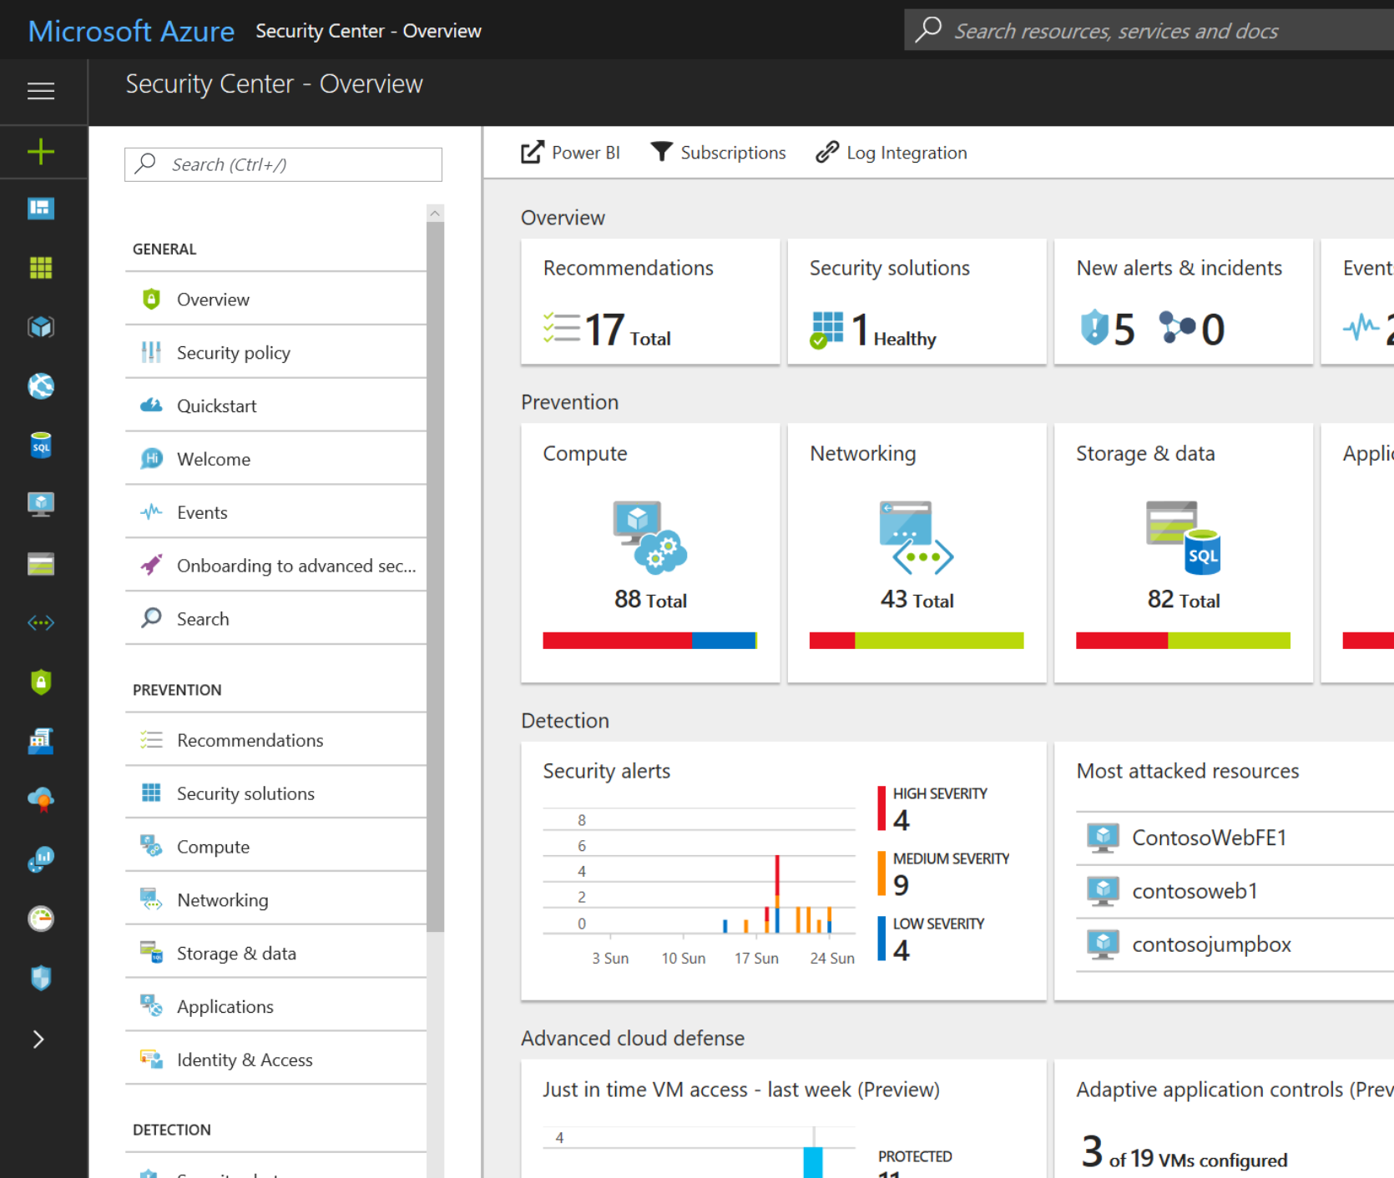
Productive
Azure
Security Center
Hybrid
Protection through best practices
Detect threats and attacks
Remediate issues
Intelligent
Trusted
Notes:
Understand security state across on-premises and cloud workloads
Get a unified view of security across all of your on-premises and cloud workloads. Automatically discover and onboard new Azure resources, and apply security policies across your hybrid cloud workloads to ensure compliance with security standards. Collect, search, and analyze security data from a variety of sources, including firewalls and other partner solutions.
Find vulnerabilities and remediate quickly
Continuously monitor the security of your machines, networks, and Azure services using hundreds of built-in security assessments or create your own. Use actionable security recommendations to remediate issues before they can be exploited.
Limit your exposure to threats
Enable adaptive threat protections to reduce exposure to attacks. Block malware and other unwanted code by applying application controls adapted to your specific workloads and powered by machine learning. Enable just-in-time, controlled access to management ports on Azure VMs to drastically reduce surface area exposed to brute force and other network attacks.
Detect and respond swiftly to attacks
Use advanced analytics and the Microsoft Intelligent Security Graph to get an edge over evolving cyber attacks. Leverage built-in behavioral analytics and machine learning to identify attacks and zero-day exploits. Monitor networks, machines, and cloud services for incoming attacks and post-breach activity. Streamline investigation with interactive tools and contextual threat intelligence.

Slide 16
Azure. Cloud for all.
Productive
Hybrid
Intelligent
Trusted
Notes:
Azure. Cloud for all.
These 4 pillars represent the main value proposition for what differentiates Azure from the competition.
As you can see in the proof points, these are the reason why customers choose Microsoft, because of the unique value that we provide in a productive, hybrid, intelligent, and trusted cloud.
With Azure, you can do—or be—all of these things.
Productive
Get unparalleled developer productivity with integrated tools from mobile DevOps to serverless computing.
Learn about accelerating innovation
Hybrid
Develop and deploy where you want, with the only consistent hybrid cloud on the market. Extend Azure on-premises with Azure Stack.
Learn about our consistent hybrid cloud
Intelligent
Create intelligent apps that delight with data-driven experiences. Go quickly from concept to release with Azure data services and artificial intelligence, from image recognition to bot services.
Learn about intelligent apps
Trusted
Join startups, governments, and 90 percent of Fortune 500s that trust the Microsoft Cloud for security, privacy, transparency, and the most compliance coverage of any cloud provider.

Slide 17
Tools
Tools
Developer tools
DevOps
Portal + scripting
Advanced workloads
Web + mobile Internet of Things
Microservices
Containers
Serverless
Identity
Data + analytics
Artificial intelligence
Cognitive services
High performance computing
Advanced workloads
Trusted
Azure Stack + Hybrid
Productive
Intelligent
Hybrid
Azure Stack + Hybrid
Core infrastructure
Core infrastructure
Security
Management
Compute
Storage
Networking
Notes:
Azure Marchitecture
This is a broad overview of the 140+ azure services we have available for customer use.
They are organized by Tools, Advanced workloads (PaaS), core infra (IaaS), and Azure Stack + hybrid.
This is not a complete listing of all the of the services, but highlights some of the key/main areas that customers need.

Slide 18
Assessment Process
Agreement to proceed
Initial Meeting
Configuration & Setup
Assessment
Consultation
Roadmap to Migration
Inital meeting to discuss the Datacenter Cloud Assessment 15-30 minutes
Configuration of required tools to connect to your environment 2-5 days
Assessment report and concusion 3-4 days Preliminary (as is no usage based optimization)
14-30 days Final
Post deployment
Consultation meeting to discuss the report and conclusion of your cloud assessment 30-60 minutes
Meeting to outline plans for your migration to the cloud 30-60 minutes
Notes:
Moving to HANA might be on the top of CIOs minds these days, but modernizing SAP environments doesn’t have to be just about the move to HANA. By bringing the benefits of the cloud into your SAP landscapes, you achieve significant cost savings and agility. This gets you one step closer to transformation even if you are planning on HANA transition down the road.
Azure has a wide set of SAP Netweaver certifications for production and non-production scenarios so you can take immediate advantage of the cloud scale, speed and economics.
For instance, you can run your Dev/Test for SAP environments on pay-as-you-go VM infrastructure and save 40-75% on TCO. You can implement DR in Azure with out-of-the-box DRaaS capabilities of Azure. This differentiates Azure from other public cloud providers.
You can use cheap and reliable storage to save your enormous SAP historical data for archiving or compliance purposes. Of course, you can run your production environments in Azure as well and free up datacenter capacity or consolidate datacenters.
On top of all the cost efficiencies and agility, you can also take advantage of Azure services like ML to drive insights from your business data and optimize your business processes with the new-found intelligence.

Slide 19
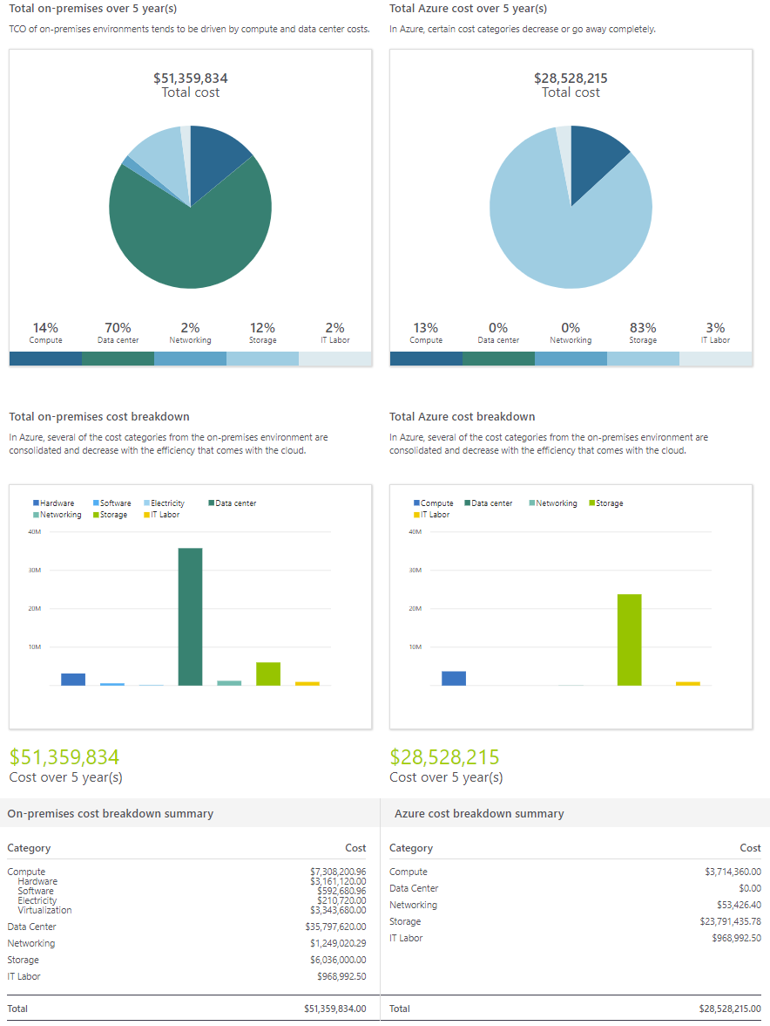
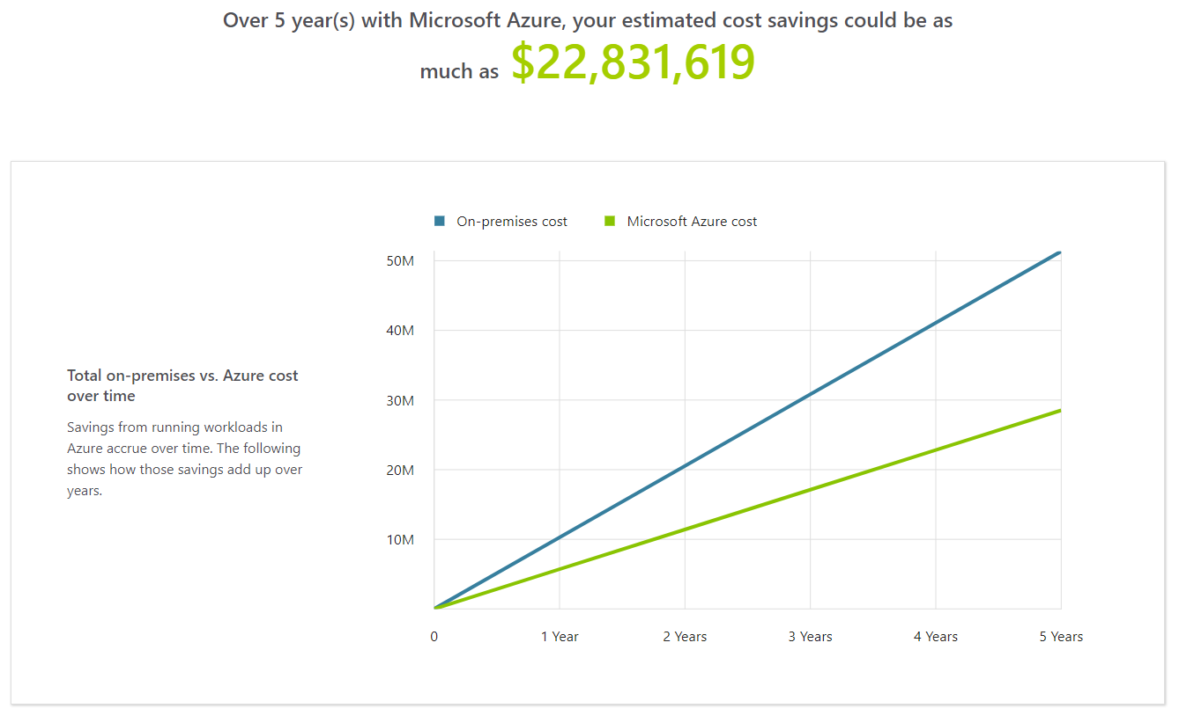
Assessment Outcome
TCO Comparison

Slide 20
Assessment Outcome
Migration Roadmap Details
Workarounds and Guidance
Guest OS Version
General Disk Requirements
Windows OS Requirements
Hypervisor Requriements
Disk Space Requirements
.NET Version Requirements
Machine Name Length Requirements
Boot Software Requirements
VMware Tools Installed
Linux System Requirements
Change OS to Windows Server 2008 R2 or later (very difficult)
Upgrade .Net version to 3.5.1 or greater (not difficult)
Compute Optimization
…etc.
Storage Optimization

Slide 21
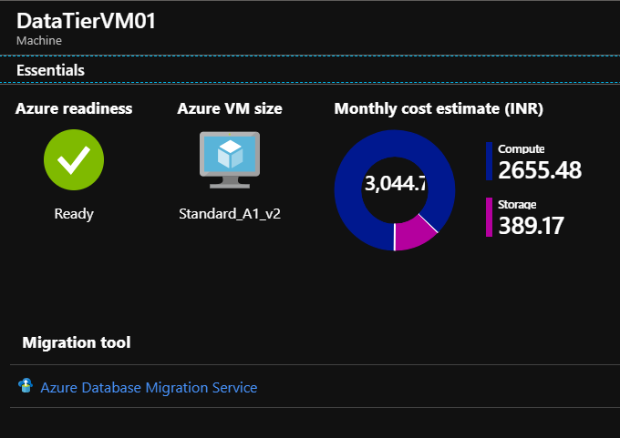
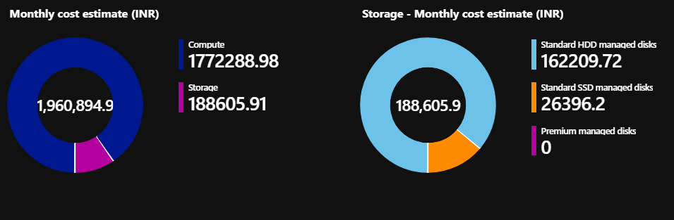
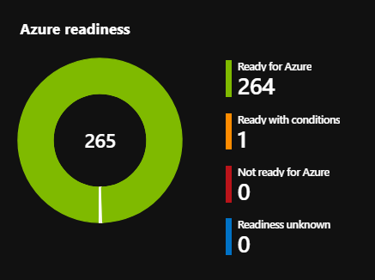
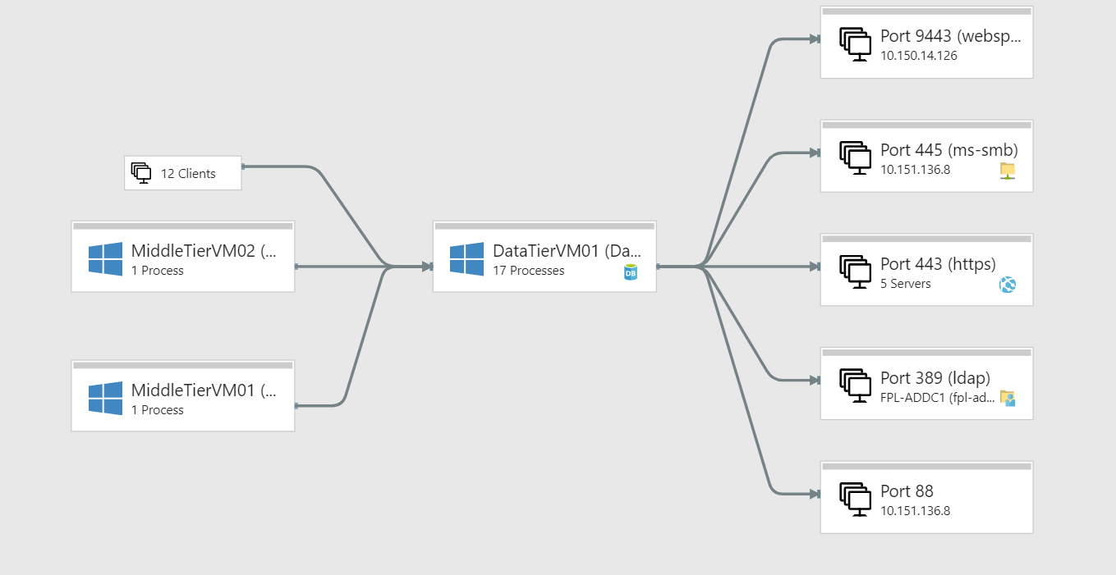
Assessment Outcome

Slide 22
Assessment Proposal
Introduction
Assessment
Business Overview
Business Case
Assessment Report
Proposal
Target State Architecture / Solution Components
Execution Strategy
Timelines
Project Deliverables
Resources
Execution Strategy Cont.
Project Risk Management
Dependencies
Governance
Expected Results
Financial Benefits
Technical Benefits
Other Benefits
Costs / Pricing & TCO
Assumptions
Conclusion

Slide 23
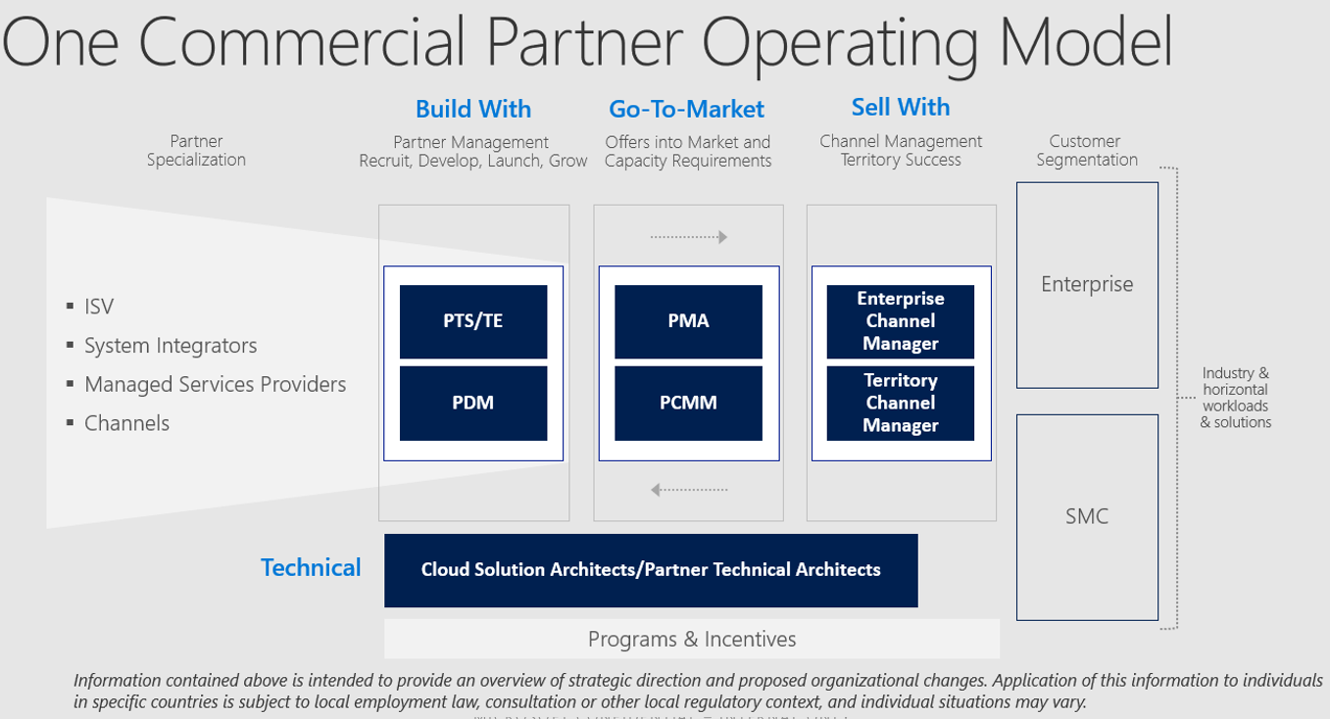
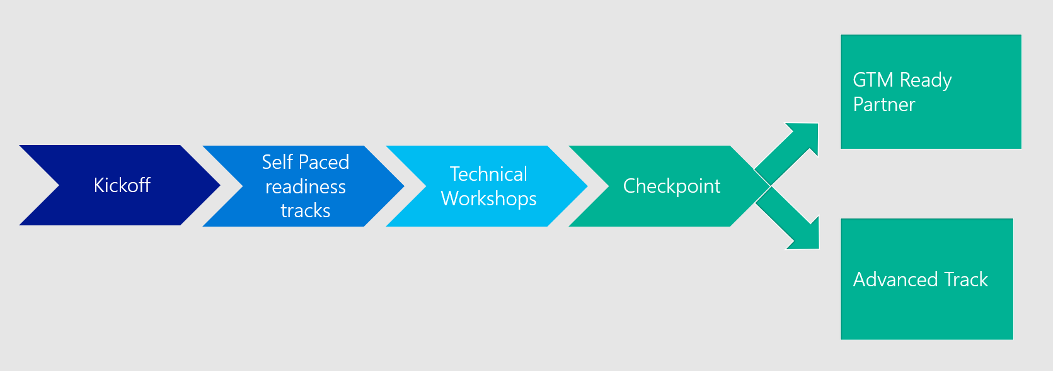
Partner Acceleration Framework Partners
Microsoft partners delivering
Microsoft solutions
Microsoft‘s One Commercial Partner & STU technical teams
Microsoft‘s partners supported by Microsoft‘s architects
Specialist System Integrators & Managed Service Providers enrolled in to Microsoft‘s Partner Acceleration Framework
Partner Acceleration Framework

Slide 24


Thank You!

